Slide 1
Name: S Devadarshini
Reg.No.: 211521104035
Naan Mudhalvan Id: au211521104035
College Name: Panimalar Institute of Technology

Slide 2
Project Title
Mushroom classification with ANN

Slide 3
AGENDA
Problem Statement
Project Overview
Who are the end users?
Solution and its value proposition
The wow in the solution
Modelling
Conclusion

Slide 4
Problem Statement
In the field of data analytics, there exists a need to develop a comprehensive classification system for mushrooms based on various attributes such as taxonomy, edibility, habitat, morphology, ecological role, and medicinal properties. The lack of a unified classification framework impedes data-driven analysis and decision-making processes related to mushrooms, which are essential for various applications including food safety, biodiversity conservation, pharmaceutical research, and ecological studies.

Slide 5
Project Overview
Data Collection: Gather data from diverse sources, including scientific literature, databases, and expert knowledge, covering various attributes of mushrooms.
Data Preprocessing: Cleanse, integrate, and preprocess the collected data to ensure consistency and accuracy across different attributes and sources.
Feature Engineering: Extract meaningful features from the preprocessed data to represent different characteristics of mushrooms, such as cap shape, gill type, and medicinal compounds.
Model Development: Utilize machine learning and statistical techniques to develop classification models capable of categorizing mushrooms based on their attributes.
Model Evaluation: Assess the performance of the developed models using appropriate evaluation metrics and cross-validation techniques to ensure reliability and generalizability.
Model Deployment: Deploy the trained classification models as part of a user-friendly application or platform, allowing stakeholders to classify mushrooms and access relevant information easily.
Continuous Improvement: Continuously update and refine the classification system based on feedback, new data, and advances in data analytics techniques to enhance its accuracy, usability, and scalability over time.

Slide 6
Who are the end users?
Mycologists and Taxonomists: Professionals studying fungi and taxonomy can use the classification system to accurately identify and categorize mushrooms based on their taxonomy, morphology, and ecological characteristics.
Food Safety Agencies: Regulatory bodies and food safety agencies can utilize the system to identify edible and poisonous mushrooms, helping to prevent incidents of mushroom poisoning and ensure the safety of consumers.
Pharmaceutical Researchers: Researchers in the pharmaceutical industry can benefit from the system by identifying mushrooms with medicinal properties and exploring their potential applications in drug development and healthcare.
Ecologists and Conservationists: Ecologists and conservationists can use the classification system to study the biodiversity of mushrooms, assess their ecological roles, and inform conservation efforts aimed at preserving mushroom habitats and species diversity.
Healthcare Professionals: Healthcare professionals, including doctors and herbalists, can use the system to identify mushrooms with therapeutic properties and recommend them for complementary and alternative medicine practices.

Slide 7
Solution and its value proposition
Accurate Identification: The classification system offers precise identification of mushrooms based on their taxonomy, morphology, and other attributes, enabling users to distinguish between edible, poisonous, and medicinal varieties with confidence.
Enhanced Food Safety: Food safety agencies and consumers can use the system to identify safe-to-consume mushrooms, reducing the risk of mushroom poisoning and enhancing public health.
Scientific Research: Researchers in mycology, ecology, and pharmaceuticals can access a wealth of data on mushroom attributes, facilitating studies on biodiversity, ecological roles, and medicinal properties of mushrooms.
Conservation Efforts: Ecologists and conservationists can utilize the system to assess the ecological importance of mushrooms, identify threatened species, and inform conservation strategies aimed at preserving fungal biodiversity and habitats.
Healthcare Applications: Healthcare professionals can benefit from the system by identifying mushrooms with therapeutic properties, potentially leading to the discovery of new medicinal compounds and complementary treatment options.

Slide 8
The Wow in the solution
The wow factor in the proposed solution lies in its ability to revolutionize the way mushrooms are understood, classified, and utilized across various domains. Here are some key wow factors:
Precision and Accuracy: The system employs cutting-edge data analytics techniques to provide highly accurate and precise classification of mushrooms. This precision ensures that users can confidently identify mushrooms for various purposes, such as consumption, research, or conservation.
Comprehensive Insights: By incorporating multiple attributes such as taxonomy, edibility, habitat, morphology, ecological role, and medicinal properties, the system offers comprehensive insights into the diverse world of mushrooms. This depth of information goes beyond mere identification and enables users to gain a holistic understanding of mushrooms and their ecological significance.
Real-World Impact: The solution addresses real-world challenges such as food safety, biodiversity conservation, and healthcare by providing actionable insights and information. It has the potential to significantly reduce incidents of mushroom poisoning, inform conservation efforts, and contribute to the discovery of novel medicinal compounds.
Innovation in Data Analytics: The use of advanced data analytics techniques, including machine learning and statistical modeling, represents a pioneering approach to mushroom classification. This innovation not only enhances the accuracy and efficiency of classification but also opens up new avenues for research and discovery in mycology and related fields.

Slide 9
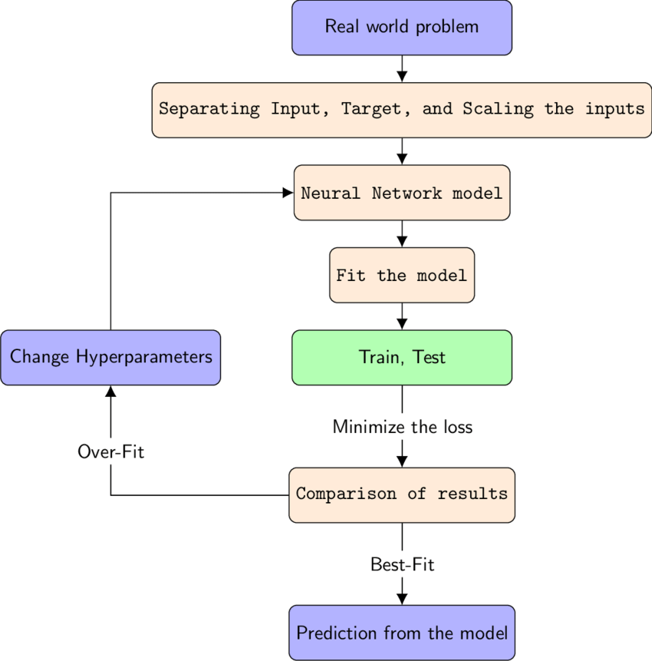
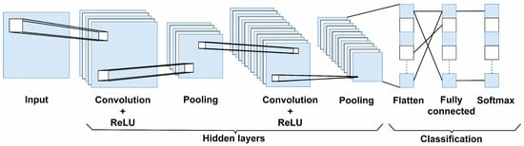
Modelling

Slide 10
Conclusion
In conclusion, the proposed data-driven classification system for mushrooms offers a groundbreaking solution that revolutionizes the understanding, categorization, and utilization of mushrooms. Through its precision, comprehensiveness, and real-world impact, the system addresses critical challenges in food safety, biodiversity conservation, and healthcare while driving innovation in data analytics applied to mycology. Its accessibility, usability, and educational value make it a transformative tool for stakeholders across various industries and disciplines, inspiring informed decision-making and advancing scientific research in the fascinating world of mushrooms and fungal biodiversity.

